Slide 1
Graphs
Chapter 9

Slide 2
Trees
So far we have talked mostly about things stored in trees or arrays.
Trees can have hierarchical or parent-child relationships
Sometimes you want a less rigid structure

Slide 3
Structures
Friendships
For our class, can you represent the friendships in a tree?
Maps
Can I put a road map in a tree?

Slide 4
Structures
We need a less rigid structure that allows relationships between any two nodes
This is where we get graphs

Slide 5
Graphs
Graphs are made up of a set of vertices and a set of edges
Vertices are data points
Edges connect vertices and are the relation

Slide 6
Graphs
Vertices are data points
In friendships they would be people
In a map, they would be cities
Edges connect vertices and are the relation
In friendships the edge would represent a friendship between the two people it connects
In a map, the edge would be a road connecting the cites

Slide 7
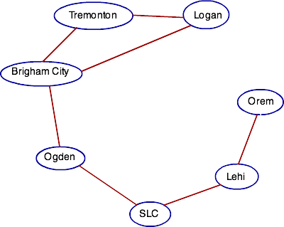
Graphs

Slide 8
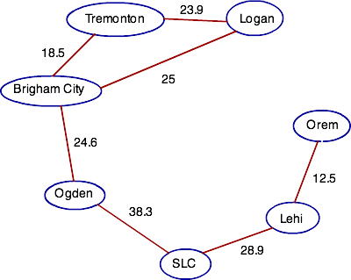
Edges
Sometimes the edges are not all of equal value

Slide 9
Edges
Sometimes the edges are not all of equal value
Weighted Graph

Slide 10
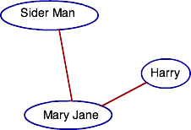
Edges
Sometimes the edges are only one way

Slide 11
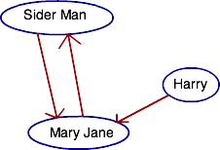
Edges
Sometimes the edges are only one way
Directed Graph or Digraph

Slide 12
Vertices
Degree
The number of edges incident to a vertex
This means the number of edges touching the vertex

Slide 13
Vertices
Degree
In a digraph, there is an in-degree and out-degree
In-degree is the number of edges coming in
Out-degree is the number of edges leaving

Slide 14
Example
Relation is same age

Slide 15
Example
Is it directed or un-directed?
Connected means every node can reach every other node
Is it connected?
Complete means everything is related to everything else
Is it complete?

Slide 16
Example
Now relation is liking

Slide 17
Example
Is it directed or un-directed?
Is it connected?
Is it complete?
Who has the largest in-degree?
What does that mean about them?
Who has the largest out-degree?
What does that mean about them?

Slide 18
Graphs
How could we store a graph?

Slide 19
Graphs
Remember (before the internet) the roadmaps that had charts of cities and the distances in between?
 | SF | LA | SLC | NYC
SF | - | 382 | 732 | 2905
LA | 382 | - | 578 | 2446
SLC | 732 | 578 | - | 2177
NYC | 2905 | 2446 | 2177 | -

Slide 20
Graphs
We can do something similar and store edges in a 2 dimensional array
 | Logan | Tremonton | Brigham | Ogden | SLC | Lehi | Orem
Logan | 0 | 23.9 | 25
Tremonton | 23.9 | 0 | 18.5
Brigham | 25 | 18.5 | 0 | 24.6
Ogden |  |  | 24.6 | 0 | 38.3
SLC |  |  |  | 38.3 | 0 | 28.9
Lehi |  |  |  |  | 28.9 | 0 | 12.5
Orem |  |  |  |  |  | 12.5 | 0

Slide 21
Graphs
Called an adjacency matrix
Store a boolean for existence or the weight of an edge
 | Logan | Tremonton | Brigham | Ogden | SLC | Lehi | Orem
Logan | 0 | 23.9 | 25
Tremonton | 23.9 | 0 | 18.5
Brigham | 25 | 18.5 | 0 | 24.6
Ogden |  |  | 24.6 | 0 | 38.3
SLC |  |  |  | 38.3 | 0 | 28.9
Lehi |  |  |  |  | 28.9 | 0 | 12.5
Orem |  |  |  |  |  | 12.5 | 0

Slide 22
Graphs
The problem with this is that there is a ton of wasted space
 | Logan | Tremonton | Brigham | Ogden | SLC | Lehi | Orem
Logan | 0 | 23.9 | 25
Tremonton | 23.9 | 0 | 18.5
Brigham | 25 | 18.5 | 0 | 24.6
Ogden |  |  | 24.6 | 0 | 38.3
SLC |  |  |  | 38.3 | 0 | 28.9
Lehi |  |  |  |  | 28.9 | 0 | 12.5
Orem |  |  |  |  |  | 12.5 | 0

Slide 23
Graphs
Alternative is to only store the necessary edges
Each node stores their out edges
Spider Man | ->Mary Jane
Mary Jane | ->Spider Man
Harry | ->Mary Jane

Slide 24
Graphs
Called an adjacency list
Spider Man | ->Mary Jane
Mary Jane | ->Spider Man
Harry | ->Mary Jane

Slide 25
Graphs
The downside is that you cannot find a predecessor (vertex that has an edge leading to it)
Why would this be helpful?
Spider Man | ->Mary Jane
Mary Jane | ->Spider Man
Harry | ->Mary Jane

Slide 26
Graphs
Consider a topological ordering
Need to make sure all preceding steps have been fulfilled

Slide 27
Graphs
Which implementation to use? (matrix or list)
Checking to see if there is an edge
Find predecessors
Find successors
Space

Slide 28
Graphs
The matrix is often the easiest and most efficient method.
Lets consider this class.

Slide 29
Graphs – Matrix Class
What class variables will we need?

Slide 30
Graphs – Matrix Class
What class variables will we need?
A 2 dimensional array to hold the graph
A variable for size

Slide 31
Graphs – Matrix Class
What methods?

Slide 32
Implementation
What methods?
Matrix()
~Matrix()
FindSuccessors(int vertex) – returns list of vertices
FindPredecessors(int vertex) – returns list of vertices
ExistsEdge(int to, int from) – returns bool
BuildGraph(istream& inStream) – returns void

Slide 33
Implementation
Matrix()
What needs to be done for an adjacency matrix?
What needs to be done for an adjacency list?

Slide 34
Implementation
FindSuccessors(int vertex) – returns list of vertices
What needs to be done for an adjacency matrix?
What needs to be done for an adjacency list?

Slide 35
Implementation
FindPredecessors(int vertex) – returns list of vertices
What needs to be done for an adjacency matrix?
What needs to be done for an adjacency list?

Slide 36
Implementation
ExistsEdge(int to, int from) – returns bool
What needs to be done for an adjacency matrix?
What needs to be done for an adjacency list?

Slide 37
Implementation
BuildGraph(istream& inStream) – returns void
What needs to be done for an adjacency matrix?
What needs to be done for an adjacency list?

Slide 38
Algorithms
In a graph, there are many things we might seek
Topological Ordering
Traverse the graph
Find a Path
Shortest Path
Check if Connected
Minimum Spanning
Tours

Slide 39
Topological ordering
The only rules for a topological ordering are that the preceding steps must be fulfilled
Buy ingredients, make fondant, heat chocolate, …
Buy ingredients, heat chocolate, make fondant, …

Slide 40
Topological ordering
How could we find a topological ordering?

Slide 41
Topological ordering
How could we print a topological ordering?
Look for nodes with no predecessors, these can be chosen
Choose one
If any of the children are now ready (no other unfulfilled ancestors) let them be chosen
Repeat 2 and 3 until everything has been visited.

Slide 42
Topological ordering
How could we implement a topological ordering?

Slide 43
Topological ordering
How could we implement a topological ordering?
Create an array with the predecessor counts for every vertex in the graph
Place all nodes with a 0 count in a queue/list/stack
Pop one, print it, then decrement the predecessor counts of all the children, if any reach 0, put them in the list, then repeat

Slide 44
Traversals
Remember our tree traversals
InOrder
Left, Current, Right
PostOrder
Left, Right, Current
PreOrder
Current, Left, Right
These visited the entire tree

Slide 45
Traversals
A graph traversal is a similar idea
We want to start at the current vertex and visit every vertex that is reachable
Unlike a tree, where if the root was passed all nodes would be visited, in a graph there may not be a way to visit all vertices

Slide 46
Traversals
We do two kinds of traversals on graphs
Depth-first search
Go deep first – Visit a child and all their children before visiting your next child
Breadth-first search
Go wide first - Visit all children of a node before visiting any grandchildren
These traversals often are not unique, it depends on which of your children you choose to visit first

Slide 47
Traversals
Depth-First Search

Slide 48
Traversals
Depth-First Search Implementation?

Slide 49
Traversals
Depth-First Search Implementation?
Recursive
Make a recursive call on each of your children
They will make recursive calls, so depth happens first
Need to mark nodes visited to avoid infinite recursion on loops
Can just use an array of booleans

Slide 50
Traversals
Breadth-First Search

Slide 51
Traversals
Breadth-First Search Implementation?

Slide 52
Traversals
Breadth-First Search Implementation?
Harder because recursion does depth first
Visit original node and place all children in a FIFO queue
Pop from the queue and repeat
All children will come out of the queue before any grandchildren can

Slide 53
Find a Path
Suppose we want to find if there is a path between A and H, how would we do this?

Slide 54
Find a Path
Suppose we want to find if there is a path between A and H, how would we do this?
Do either a depth-first or breadth-first from A, and return true if you find H

Slide 55
Find a Path
How about printing the path between A and H?

Slide 56
Find a Path
How about printing the path between A and H?
Do a depth first, passing an array or string of the nodes visited so far
When you find H, print the array/string
Make sure that items get removed from the path if they fail to reach H

Slide 57
Shortest Path
How could we find the length of the shortest path from A to H?

Slide 58
Shortest Path
How could we find the length of the shortest path from A to H?
Could try a greedy approach, choose what seems best at the time

Slide 59
Shortest Path
How could we find the length of the shortest path from A to H?
A greedy approach is not optimal
Can get the optimal using a breadth first search
When you reach H, you have the guaranteed shortest path

Slide 60
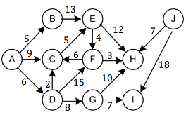
Shortest Path
How could we find the length of the shortest path from A to H?
How about a weighted graph?

Slide 61
Shortest Path
How could we find the length of the shortest path from A to H?
How about a weighted graph?
Do something similar to breadth first, but use a minimum priority queue

Slide 62
Shortest Path
Dijkstra’s Algorithm
Put the edges of A in a min queue
Pop the edge with the smallest path length
Look at the node it leads to and place the out edges in the queue with the total path length
Continue popping edges until you find H

Slide 63
Shortest Path
Dijkstra’s Algorithm
Put the edges of A in a min queue
5 B
6 D
9 C

Slide 64
Shortest Path
Dijkstra’s Algorithm
Pop the edge with the smallest path length
Look at the node it leads to and place the out edges in the queue with the total path length
5 B
6 D
9 C

Slide 65
Shortest Path
Dijkstra’s Algorithm
Pop the edge with the smallest path length
Look at the node it leads to and place the out edges in the queue with the total path length
Continue popping edges until you find H
6 D
9 C
13 E

Slide 66
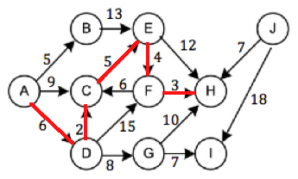
Shortest Path
Dijkstra’s Algorithm

Slide 67
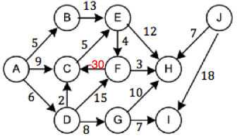
Shortest Path
Dijkstra’s Algorithm
This will not work with negative edge weights. Why?

Slide 68
Shortest Path
Dijkstra’s Algorithm
This will not work with negative edge weights. Why?
If C is marked visited after A, D, C then A, D, F, C is not allowed, but it is shorter
Can fix that by not checking visited, but then having a cycle with negative cost will cause an infinite loop

Slide 69
Longest Path
Dijkstra’s Algorithm can be modified to compute the longest path.
This may be useful if you are looking at an ordering of tasks and want to know the soonest you can finish

Slide 70
Longest Path
Longest path indicates the fastest you can buy a house

Slide 71
Connectedness
Connected means every vertex can reach every other vertex. Examples?

Slide 72
Connectedness
In an undirected graph how can you check for connectedness?

Slide 73
Connectedness
In an undirected graph how can you check for connectedness?
Do a traversal, then check to see if all vertices were visited.

Slide 74
Connectedness
How about a directed graph?

Slide 75
Connectedness
How about a directed graph?
Do a search again and check for all nodes being visited
But this does not account for a node with only in edges (like H below)
Repeat the search for every vertex

Slide 76
Connectedness
A directed graph is unconnected, weakly connected, or strongly connected
Consider edges as undirected and check if connected
If so, then it is weakly connected
Consider directed edges and check if connected
If so, then it is strongly connected
If neither, then unconnected

Slide 77
Connectedness
Give me an example of a weakly connected digraph.

Slide 78
Connectedness
Give me an example of a strongly connected digraph.

Slide 79
Connectedness
Give me an example of an unconnected digraph.

Slide 80
Network Flow
Network flow problems look at flow through a network
Network could be
Water pipes
Power grid
Goods transported on roads
Information being transported through the internet

Slide 81
Network Flow
Information being transported through the internet
Computers and routers would be vertices
Edges would represent wired/wireless connections
An edge has bandwidth, so a limit on the maximum amount of data that can “flow” through it

Slide 82
Network Flow
Water through pipes
Intersections of pipes would be vertices
Edges would represent pipes
An pipe has a diameter which limits how much water can flow through it

Slide 83
Network Flow
The idea of Network Flow problems are that you have a source (water treatment plant) and a sink (a housing complex)
You want to use your infrastructure to send the maximum amount possible to your sink
Decide how much water to send down each pipe to get maximum flow

Slide 84
Network Flow
How much can be transported across the network?

Slide 85
Network Flow
How much can be transported across the network?
Could do a greedy approach and choose the best edge
But may get stuck with a sub-optimal solution

Slide 86
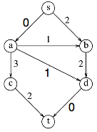
Network Flow
For instance, if we send 3 from s to a, then from a to d, then from d to t
The right graph is a residual graph, how much is left after choosing a flow.

Slide 87
Network Flow
Even with a non-greedy approach this could happen because we just happened to choose s->a->d

Slide 88
Network Flow
In order to get an optimal solution, we need to be able to change our minds
We can do this by sending flow backwards

Slide 89
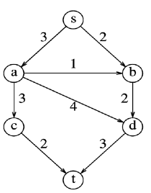
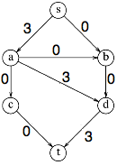
Network Flow
So after doing s->a->d->t, when we try s->b->d, we can change our minds, and send 2 back up a->d to have it flow a->c->t

Slide 90
Network Flow
These algorithms are fairly complex to write. Generally you should only send one unit down at a time because it simplifies the cases to be considered.

Slide 91
Spanning Trees
The set of all vertices and some edges to build a tree
Think of a calling tree
I want everyone called but only called once

Slide 92
Spanning Trees
How do you implement a spanning tree?

Slide 93
Spanning Trees
How do you implement a spanning tree?
BFS or DFS
Visit nodes in either breadth first or depth first order.
Once visited, don’t allow vertices to be visited again.
Keep track of the edges you used.

Slide 94
Minimum- Cost Spanning Trees
In a weighted graph, we may not want just a spanning tree, but the one that costs the least.
Consider wiring a house
You have a bunch of outlets that need to be connected to the breaker box
Copper is expensive, so you want to use as little wire as possible

Slide 95
Minimum- Cost Spanning Trees
Consider wiring a house
Vertices are outlets, edges are potential wire paths
Vertex 1 is my breaker box, how can I get power from there to all the outlets with minimal cost?

Slide 96
Minimum- Cost Spanning Trees
Prim’s algorithm
Put in a min queue all edges coming off source
Pop an edge
If the vertex it leads to is already included, pop another
Place the edge in T (set of edges in tree)
Mark the destination vertex as visited
En-queue all edges coming off that vertex
Continue until the queue is empty

Slide 97
Minimum- Cost Spanning Trees
Use Prim’s algorithm

Slide 98
Minimum- Cost Spanning Trees
Kruskal’s algorithm
Put all edges in a min queue
Pop the smallest weight
Add it to T if it will not cause a cycle
How can we check to see if it will cause a cycle?
Continue until the queue is empty

Slide 99
Minimum- Cost Spanning Trees
Kruskal’s algorithm
Put all edges in a min queue and set up a disjoint set
Pop the smallest weight
Try to union the two vertices in the disjoint set
If succeed, add the edge to T
Else, pop another edge
Continue until the queue is empty or everything is in the same set

Slide 100
Minimum- Cost Spanning Trees
Use Kruskal’s algorithm

Slide 101
Minimum- Cost Spanning Trees
Use Prim’s algorithm

Slide 102
Minimum- Cost Spanning Trees
Use Kruskal’s algorithm

Slide 103
Tours
A path is just a traversal of the graph
A tour is a traversal of the graph that begins and ends at the same node.

Slide 104
Tours
Hamiltonian
Euler

Slide 105
Hamiltonian Tour
Find a path that visits every vertex exactly once, and ends in the same place it began
Edges can be repeated, but vertices cannot

Slide 106
Hamiltonian Tour
Think of a vacation
Vertices are cities, roads are edges
You want to start in Logan and want to come back
You have a list of places you want to visit
Crater Lake, Yosemite, Bryce Canyon, Redwood
You only want to visit each once

Slide 107
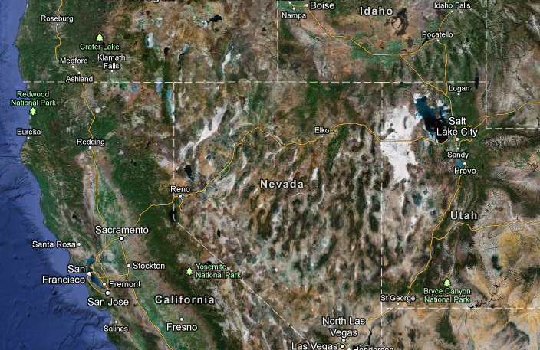
Hamiltonian Tour

Slide 108
Hamiltonian Tour
Does this graph have a Hamiltonian tour?

Slide 109
Hamiltonian Tour
Does this graph have a Hamiltonian tour?

Slide 110
Hamiltonian Tour
Does this graph have a Hamiltonian tour?

Slide 111
Hamiltonian Tour
How can we implement a Hamiltonian tour in a graph?

Slide 112
Hamiltonian Tour
How hard is this?

Slide 113
Hamiltonian Tour
How hard is this?
VERY! You must try all options
There are lots of options!
This is what we call NP complete
NP means non-deterministic polynomial time
It basically means the problem is super hard and cannot be computed in polynomial time

Slide 114
Euler Tour
Find a path that visits every edge exactly once, and ends in the same place it began
Vertices can be repeated, but edges cannot

Slide 115
Euler Tour
Think of scenic byways
Vertices are cities
You want to start in Logan and want to come back
You want to travel all byways
You only want to travel each once

Slide 116
Euler Tour

Slide 117
Euler Tour
Does this graph have a Euler tour?

Slide 118
Euler Tour
Does this graph have a Euler tour?

Slide 119
Euler Tour
Does this graph have a Euler tour?

Slide 120
Euler Tour
Are there any quick tricks for seeing if there is an Euler tour?

Slide 121
Euler Tour
Are there any quick tricks for seeing if there is an Euler tour?
Each node must have an even degree, otherwise you get stuck at a node

Slide 122
Euler Tour
How can we implement an Euler tour in a graph?

Slide 123
Euler Tour
How hard is this?

Slide 124
Euler Tour
How hard is this?
Not as hard as you may think
Though it sounds very similar to a Hamiltonian problem, it is actually a lot easier.

Slide 125
Euler Tour
You can find many small cycles in the graph fairly easily by just starting at a node and going as far as you can

Slide 126
Euler Tour
Your goal is to make one massive “cycle”
Do this by merging the small cycles you found

Slide 127
Euler Tour
Not NP because this can be done in polynomial time

Slide 128
DFS
A depth first search can be used for many things
Checking connectedness
Checking bi-connectedness
A graph that can have any vertex removed without becoming disconnected
Checking for strongly connected components
Sub-graphs that are strongly connected

Slide 129
DFS
Checking bi-connectedness
Is this bi-connected?

Slide 130
DFS
Checking bi-connectedness
Look for vertices that the removal would cause problems
These are called articulation points

Slide 131
DFS
Finding articulation points
Do a DFS and number the vertices as you reach them
Direct the edges you use
If a vertex has been visited, make the edge a back edge

Slide 132
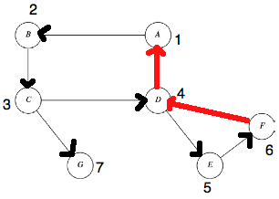
DFS
Finding articulation points
Now give each vertex a Low, which is the min of:
The DFS number
Lowest number reachable by a back edge
Lowest Low of children

Slide 133
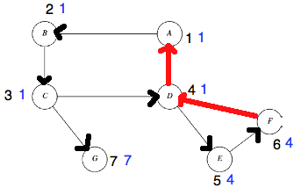
DFS
Finding articulation points
The root is an articulation point if it has more than one child
A vertex is an articulation point if any of its children have a Low greater than or equal to the DFS number
C is because Low(G) > DFS(C)
D is because Low(E) = DFS(D)

Slide 134
DFS
Checking for strongly connected components
Overall this isn’t strongly connected, but pieces are
There are sub-graphs that are strongly connected

Slide 135
DFS
Checking for strongly connected components
Do a DFS, numbering post-order (give the children their #’s first)
Start at A

Slide 136
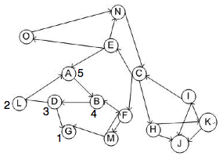
DFS
Checking for strongly connected components
May have to start again
Start again at C

Slide 137
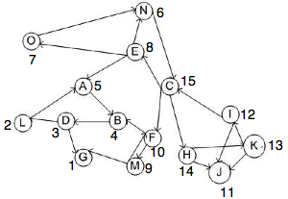
DFS
Checking for strongly connected components
Now reverse all the edges

Slide 138
DFS
Checking for strongly connected components
Now reverse all the edges

Slide 139
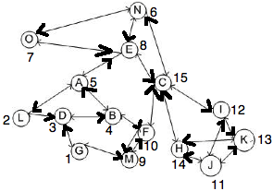
DFS
Checking for strongly connected components
Starting at the highest number, do a DFS
Everything that is reachable is a strongly connected component
May have to restart a couple times

Slide 140
DFS
Checking for strongly connected components
C, N, O, E, I, K, H
J
F, M
A, L, D, B
G

Slide 141
Shortest Path
We talked about shortest path from one vertex to another
How about shortest path from one vertex to all other vertices?

Slide 142
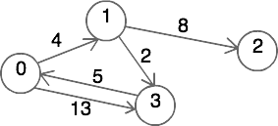
Shortest Path
The min path is the min of the length of an edge straight there and the length of visiting a few vertices on the way

Slide 143
Shortest Path
Floyd Warshall Algorithm
Finds shortest path between all pairs of vertices
Before running the algorithm, create a 2d array of ints called path and put all edges in
 | 0 | 1 | 2 | 3
0 | 0 | 4 | ∞ | 13
1 | ∞ | 0 | 8 | 2
2 | ∞ | ∞ | 0 | ∞
3 | 5 | ∞ | ∞ | 0

Slide 144
Shortest Path
Floyd Warshall Algorithm
Finds shortest path between all pairs of vertices
for k = 0 to v // specifies the node to go through
for i = 0 to v // starting point
if path[i,k] != infinity // no path there
for j=0 to v // destination
path[i,j] = min(path[i,j], path[i,k]+path[k,j])

Slide 145
Shortest Path
for k = 0 to v // specifies the node to go through
for i = 0 to v // starting point
if path[i,k] != infinity // no path there
for j=0 to v // destination
path[i,j] = min(path[i,j], path[i,k]+path[k,j])
 | 0 | 1 | 2 | 3
0 | 0 | 4 | ∞ | 13
1 | ∞ | 0 | 8 | 2
2 | ∞ | ∞ | 0 | ∞
3 | 5 | ∞ | ∞ | 0

